Slide 1
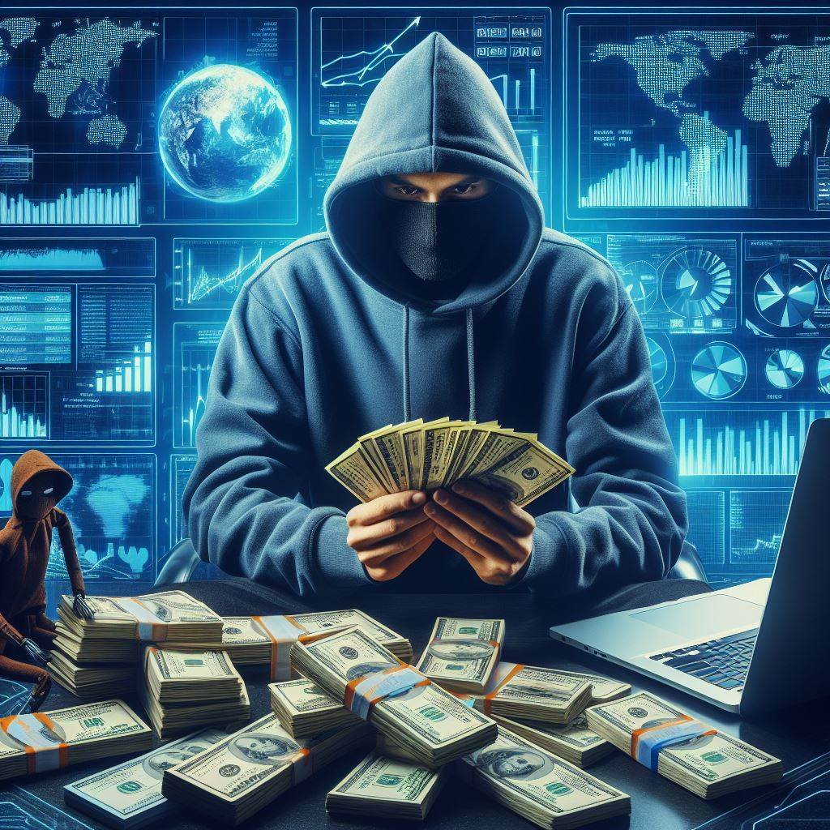

The Economics of
Notes:
This presentation/discussion is about 5 hours underbaked

Slide 2
Agenda: Discuss three works on measuring cybercrime
Industry report
Government report
Academic paper
Goals: Face our intuitions and assumptions
Notes:
I made slides, but this is not a presentation. There are elements of a presentation but this will primarily be a discussion and a group activity

Slide 3
Law enforcement
Social engineering
Crime
Cybersecurity
Ransomware
Data breaches
Identity theft
Stalking
Confidence scams
Offensive research
Defensive research
Technology

Slide 4
Law enforcement
Social engineering
Ransomware
Data breaches
Identity theft
Stalking
Confidence scams
Crime
Cybersecurity
Offensive research
Defensive research
Technology
Notes:
I don’t know if I fully endorse this, but maybe it’s something worth thinking about.

Slide 5
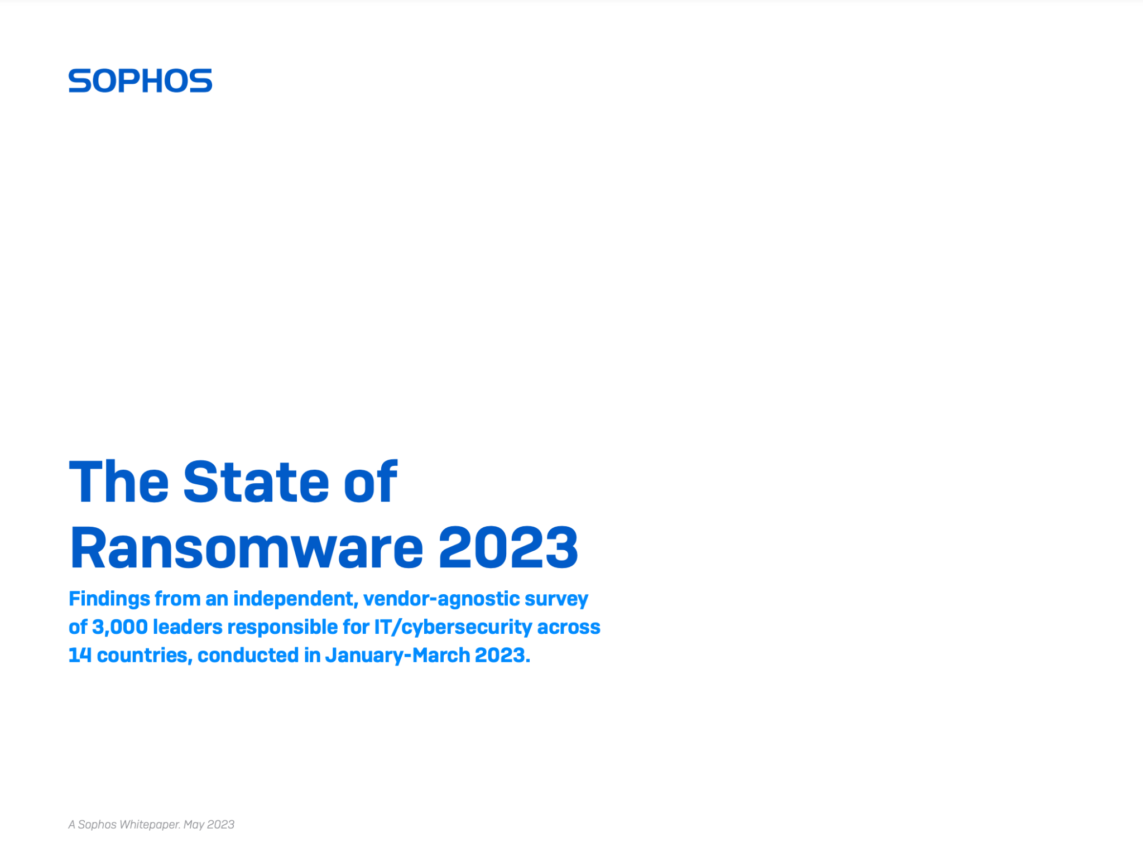

Slide 6
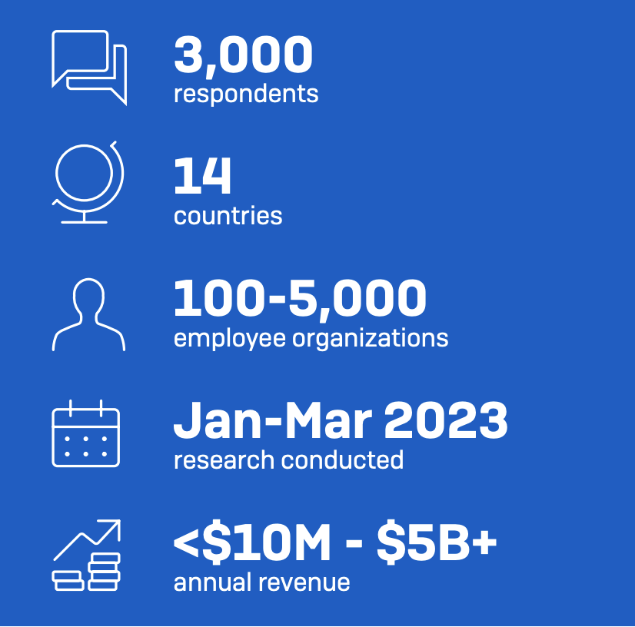
Notes:
I really don’t think you’re going to get much if I just say numbers at you.
For this to be interesting, I want you to have to face your intuitions first,
I want to force you to think about what you believe
so that when I do tell you the numbers, you can
Then update your world models

Slide 7
What percentage of respondents were hit by ransomware?
0% to 25%
25% to 50%
50% to 75%
75% to 100%

Slide 8
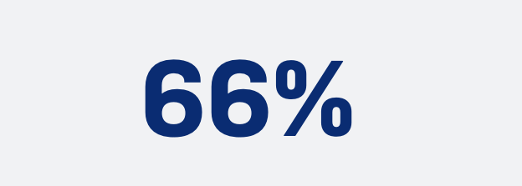
What percentage of respondents were hit by ransomware?
0% to 25%
25% to 50%
50% to 75%
75% to 100%

Slide 9
2) Which group is more likely to be hit with ransomware?
Small organizations
Large organizations
No difference

Slide 10
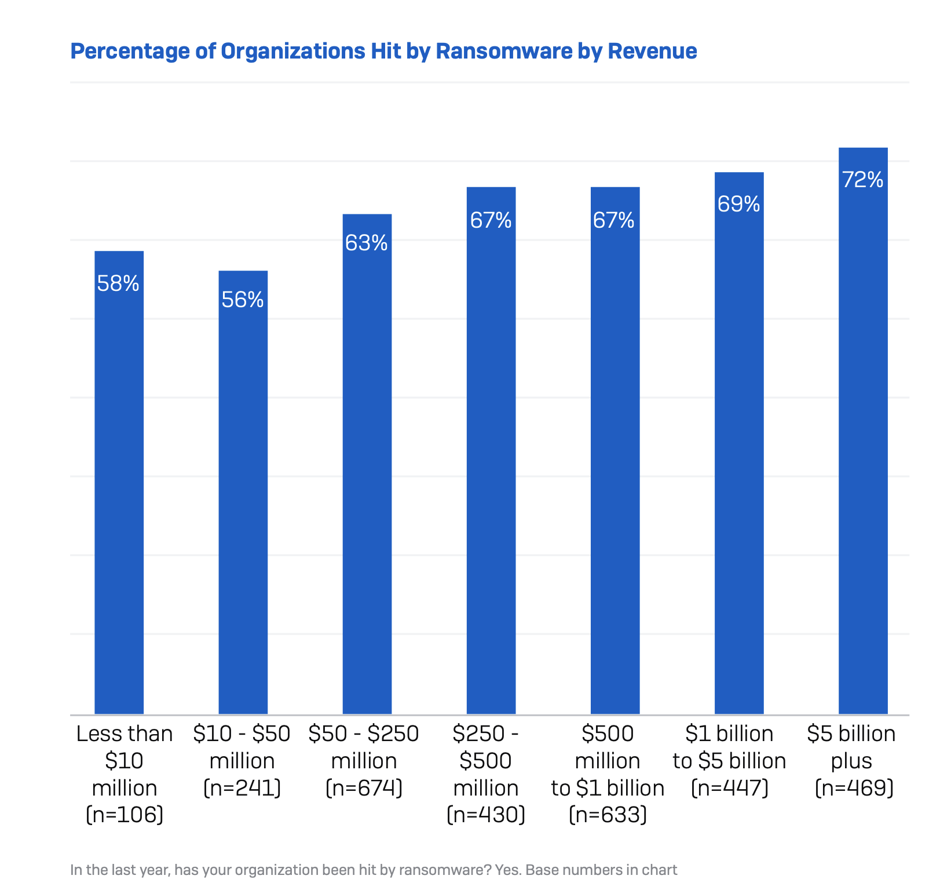
2) Which group is more likely to be hit with ransomware?
Small organizations
Large organizations
No difference

Slide 11
3) What percentage of ransomware attacks list “exploited vulnerability” as the root cause?
0% to 25%
25% to 50%
50% to 75%
75% to 100%

Slide 12
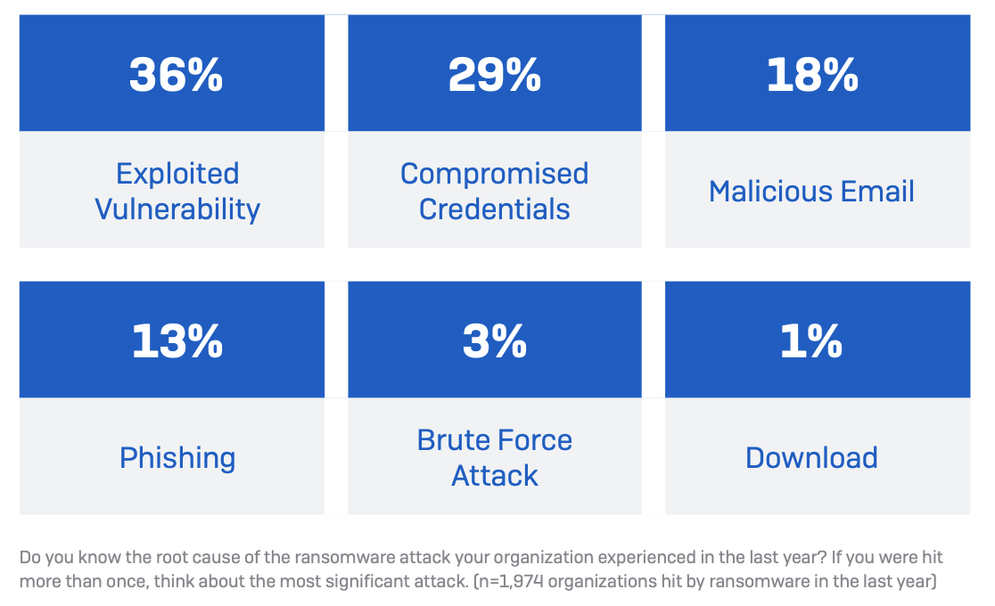
3) What percentage of ransomware attacks list “exploited vulnerability” as the root cause?
0% to 25%
25% to 50%
50% to 75%
75% to 100%

Slide 13
What percentage of ransomware attacks list “exploited vulnerability” as the root cause?
0% to 25%
25% to 50%
50% to 75%
75% to 100%
40% due to technological flaws
Notes:
“Exploited vulnerability” was the most common root cause, at 36%.
Along with “Brute-Force Attack”, we can can conclude that 40% of root causes are explicitly due to technological flaws.

Slide 14
What percentage of ransomware attacks list “exploited vulnerability” as the root cause?
0% to 25%
25% to 50%
50% to 75%
75% to 100%
40% due to technological flaws
60% due to social engineering!
Notes:
“Exploited vulnerability” was the most common root cause, at 36%.
Along with “Brute-Force Attack”, we can can conclude that 40% of root causes are explicitly due to technological flaws.

Slide 15
4) What percentage of ransomware attacks are successful?
“Successful” = data is encrypted
0% to 25%
25% to 50%
50% to 75%
75% to 100%

Slide 16
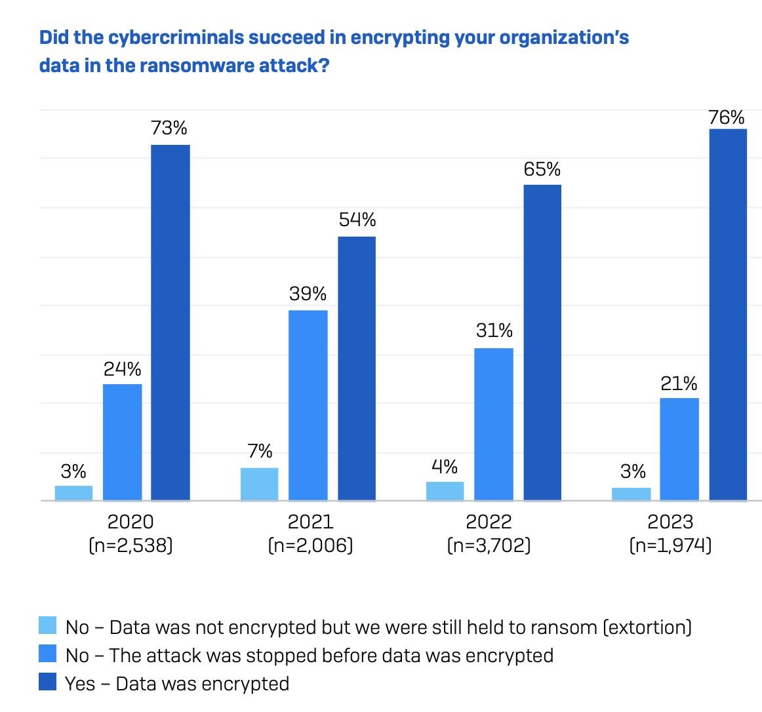
4) What percentage of ransomware attacks are successful?
“Successful” = data is encrypted
0% to 25%
25% to 50%
50% to 75%
75% to 100%
Notes:
How do we know about the attacks that aren’t successful? Won’t be reported in this data….

Slide 17
5) What percentage of victimized organizations paid ransom?
“Victimized” = had data encrypted (97% of orgs recovered data)
0% to 25%
25% to 50%
50% to 75%
75% to 100%

Slide 18
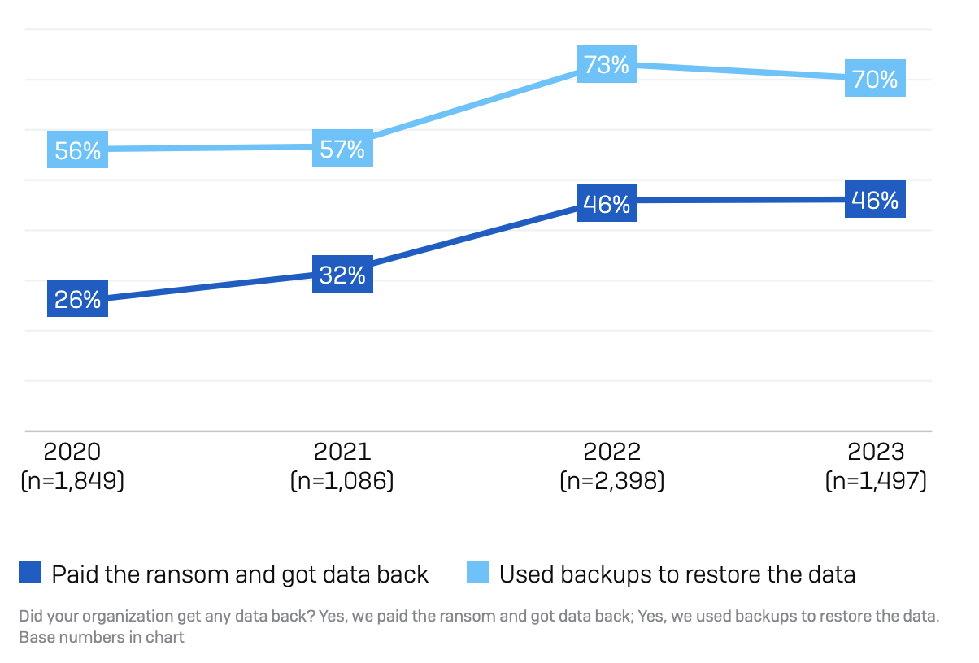
5) What percentage of victimized organizations paid ransom?
“Victimized” = had data encrypted (97% of orgs recovered data)
0% to 25%
25% to 50%
50% to 75%
75% to 100%

Slide 19
5) What percentage of victimized organizations paid ransom?
“Victimized” = had data encrypted (97% of orgs recovered data)
0% to 25%
25% to 50%
50% to 75%
75% to 100%
% attacked = 0.66
% victimized = 0.76 * (% attacked)
% paid ransom = 0.46 * (% victimized) % paid ransom = 23% ???
Notes:
This seems way too high. But what do I know?

Slide 20
5) What percentage of victimized organizations paid ransom?
“Victimized” = had data encrypted (97% of orgs recovered data)
0% to 25%
25% to 50%
50% to 75%
75% to 100%

Slide 21
6) Which group is more likely to pay ransoms?
Small organizations
Large organizations
No difference

Slide 22
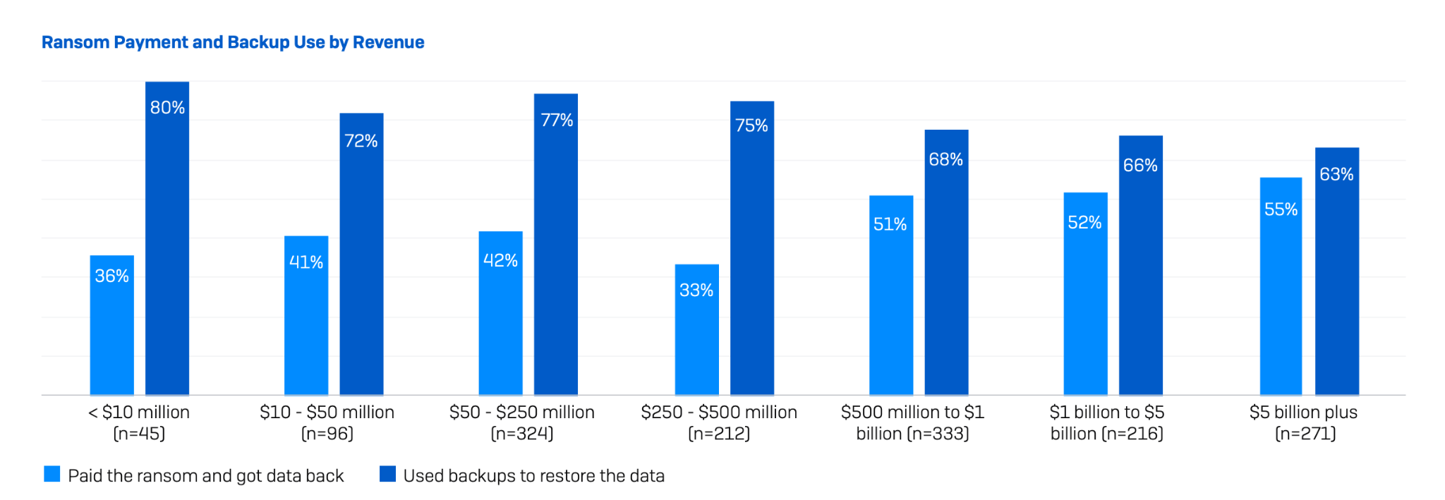
6) Which group is more likely to pay ransoms?
Small organizations
Large organizations
No difference
Notes:
Large organizations more likely to pay ransoms, less likely to use backups! Why do we think this is?

Slide 23
7) Who is more likely to recover data?
Organizations with cyber insurance
Organizations without cyber insurance
No difference

Slide 24
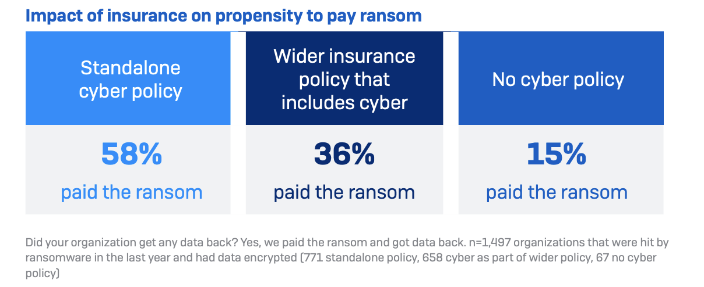
7) Who is more likely to recover data?
Organizations with cyber insurance
Organizations without cyber insurance
No difference

Slide 25
8) How much is the median ransom payment?
$400
$4,000
$40,000
$400,000
$4,000,000
$40,000,000

Slide 26
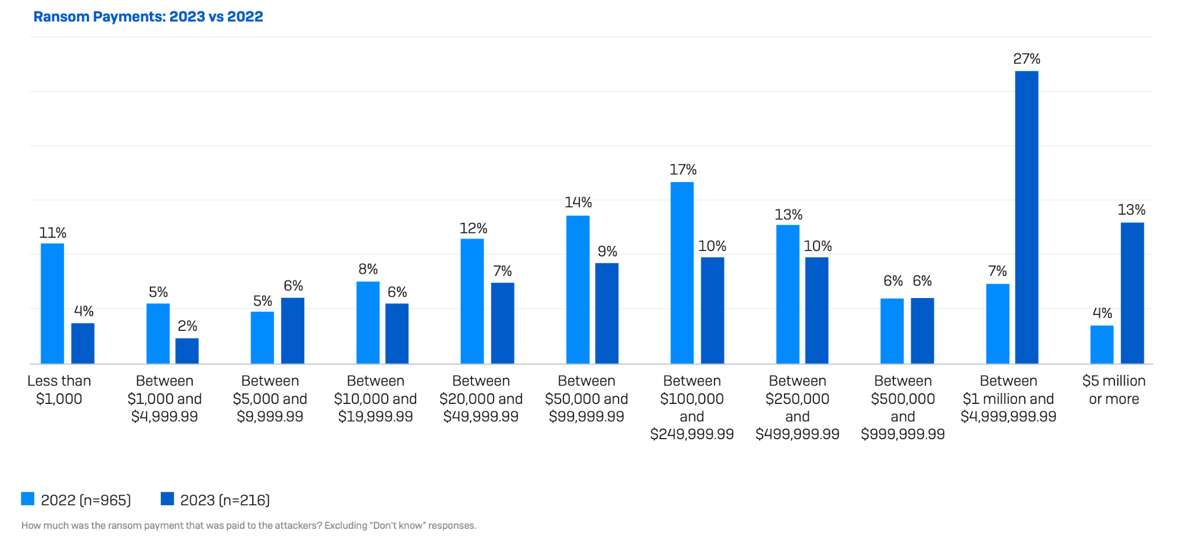
8) How much is the median ransom payment?
$400
$4,000
$40,000
$400,000
$4,000,000
$40,000,000
Median = $400K

Slide 27
8) How much is the median ransom payment?
$400
$4,000
$40,000
$400,000
$4,000,000
$40,000,000
Mean = $1.5M
Median = $400K

Slide 28
9) What is the mean recovery cost? (i.e. costs excluding the ransom)
$18
$180
$1,800
$18,000
$180,000
$1,800,000
Notes:
“Downtime, people time, device cost, lost opportunity”

Slide 29
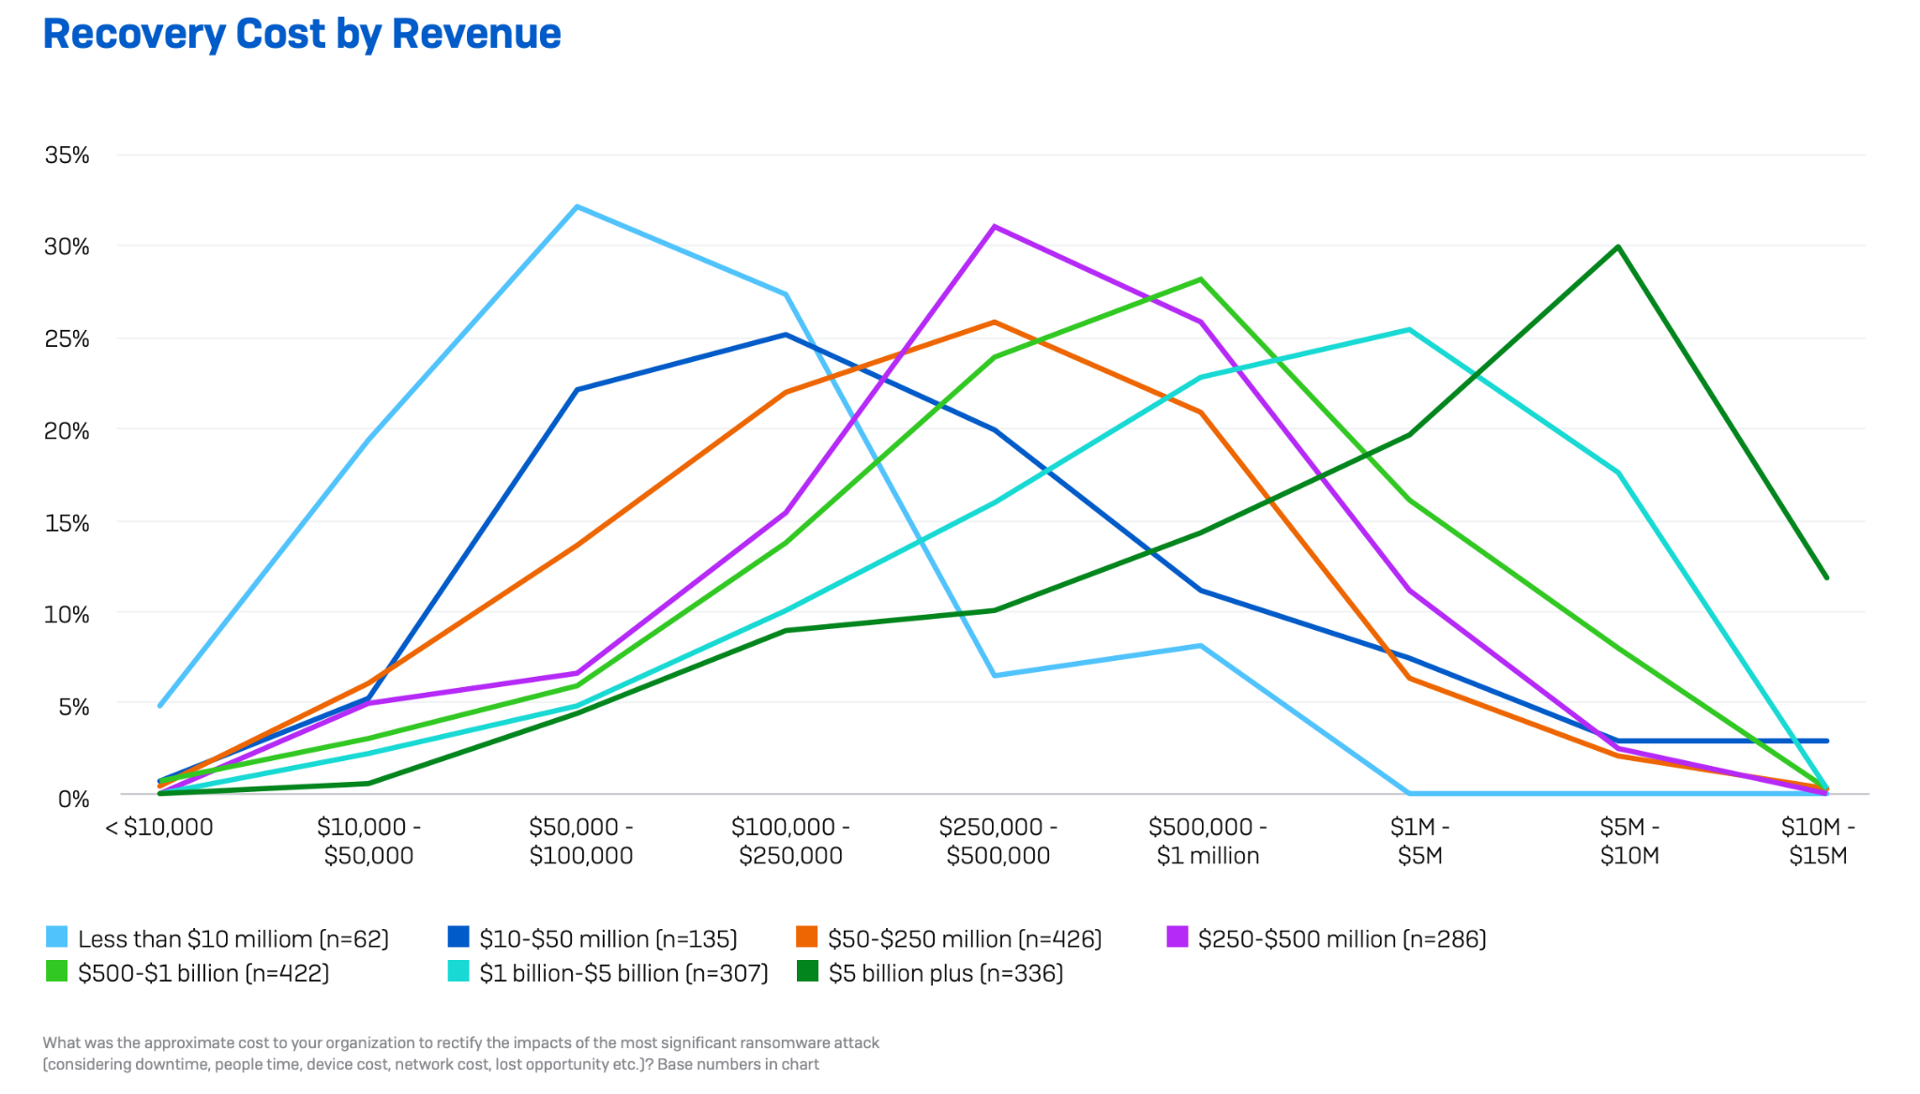
9) What is the mean recovery cost? (i.e. costs excluding the ransom)
$18
$180
$1,800
$18,000
$180,000
$1,800,000
Mean = $1.82M
Notes:
Average recovery cost is $1.82M…higher than the average ransom! (on paper)
I’m a little suspicious of this figure (e.g. if it includes cybersecurity team salary, they would have been paid either way)
Larger orgs paid more for recovery (not surprising)
I wish they had reported the mean as well.
One thing that’s not surprising is that organizations who used their backups to restore data had lower recovery costs than those who paid ransom. But not dramatically less! Only about 50% less
Most recovered in about a week to a month, but this was the same whether they paid the ransom or not!

Slide 30
10) What is the implied total cost of ransomware?
$2K
$2M
$2B
$2T

Slide 31
10) What is the implied total cost of ransomware?
median ransom = $400K
median recovery cost = $400K* (1.8M avg)
Cost per incident = $400K + $400K = $800K
Victimization rate = 22%
# of respondents = 13,000
# victims = 22% of 13,000 = 2860
Total costs: = 2860 * $800K = $2.29B
$2K
$2M
$2B
$2T
Notes:
If we use averages instead of medians, the cost is closer to $9B

Slide 32
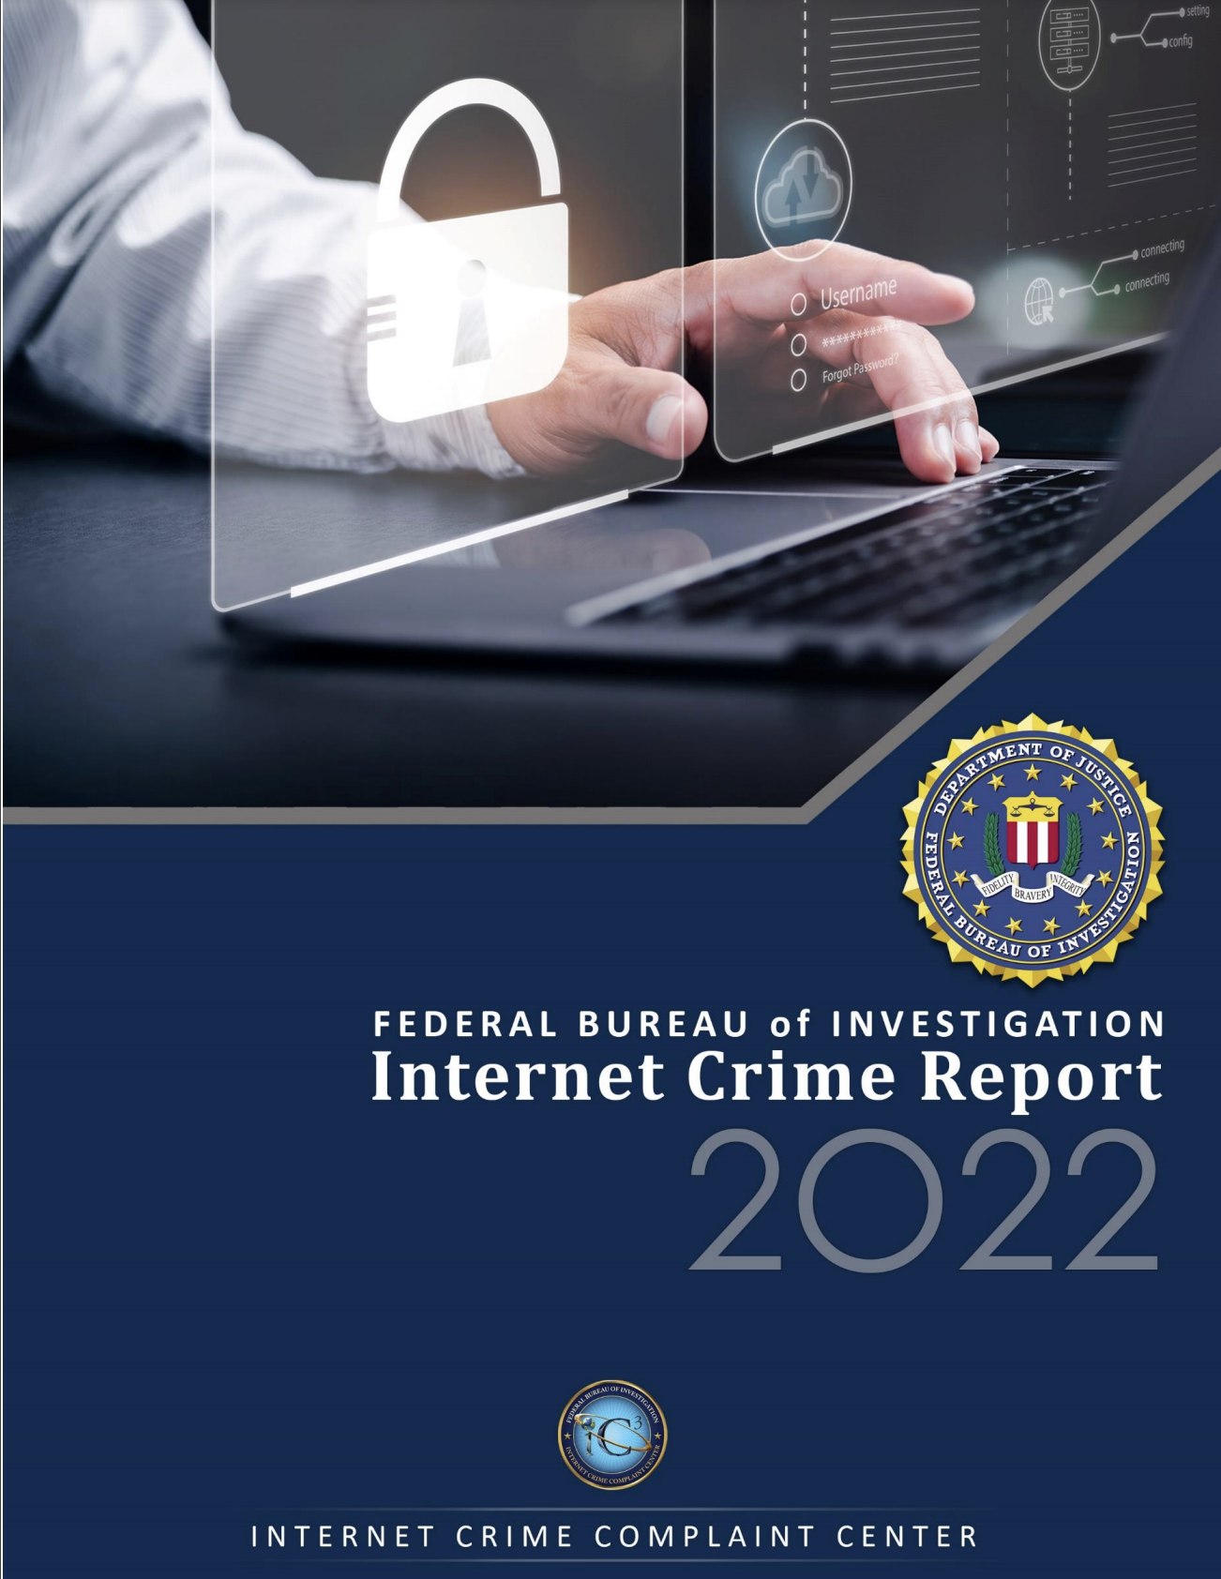

Slide 33
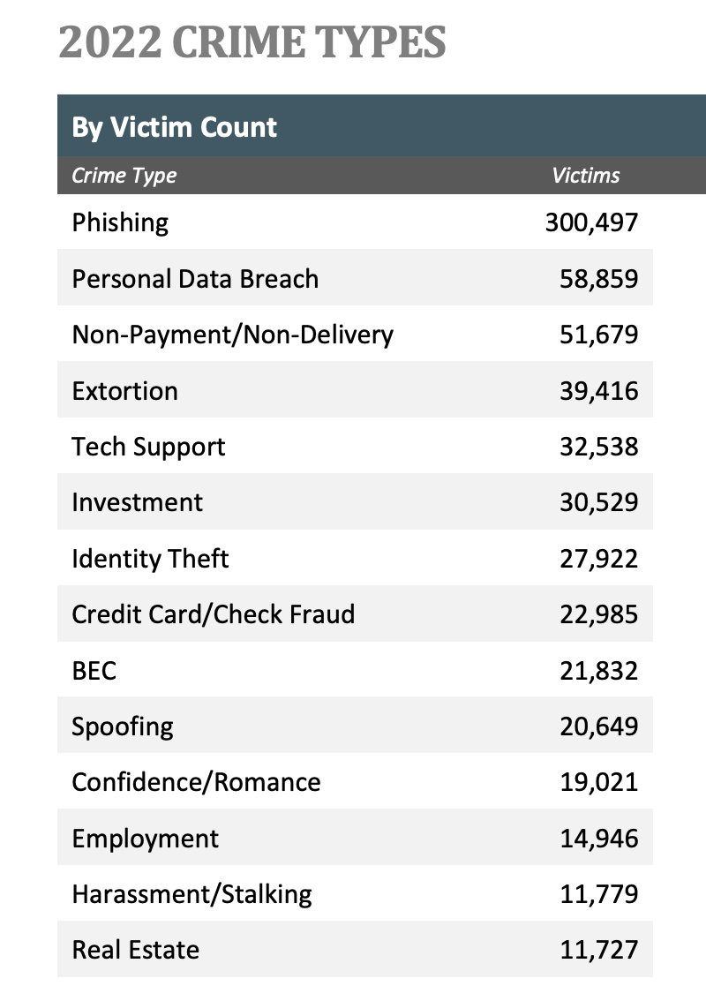
?
?
?
?
?
?
?
?
?
?
?
?
?
?
Notes:
Phishing — The use of unsolicited email, text messages, and telephone calls purportedly from a legitimate company requesting personal, financial, and/or login credentials.
Personal Data Breach — A leak/spill of personal data which is released from a secure location to an untrusted environment. Also, a security incident in which an individual’s sensitive, protected, or confidential data is copied, transmitted, viewed, stolen, or used by an unauthorized individual.
Non-Payment/Non-Delivery — Goods or services are shipped, and payment is never rendered (nonpayment). Payment is sent, and goods or services are never received, or are of lesser quality (non-delivery).
Extortion — Unlawful extraction of money or property through intimidation or undue exercise of authority. It may include threats of physical harm, criminal prosecution, or public exposure.
Tech Support — Subject posing as technical or customer support/service.

Slide 34
?
?
?
?
?
?
?
?
?
?
?
?
?
Notes:
Phishing — The use of unsolicited email, text messages, and telephone calls purportedly from a legitimate company requesting personal, financial, and/or login credentials.
Personal Data Breach — A leak/spill of personal data which is released from a secure location to an untrusted environment. Also, a security incident in which an individual’s sensitive, protected, or confidential data is copied, transmitted, viewed, stolen, or used by an unauthorized individual.
Non-Payment/Non-Delivery — Goods or services are shipped, and payment is never rendered (nonpayment). Payment is sent, and goods or services are never received, or are of lesser quality (non-delivery).
Extortion — Unlawful extraction of money or property through intimidation or undue exercise of authority. It may include threats of physical harm, criminal prosecution, or public exposure.
Tech Support — Subject posing as technical or customer support/service.

Slide 35
?
?
?
?
?
?
?
?
?
?
?
?
Notes:
Phishing — The use of unsolicited email, text messages, and telephone calls purportedly from a legitimate company requesting personal, financial, and/or login credentials.
Personal Data Breach — A leak/spill of personal data which is released from a secure location to an untrusted environment. Also, a security incident in which an individual’s sensitive, protected, or confidential data is copied, transmitted, viewed, stolen, or used by an unauthorized individual.
Non-Payment/Non-Delivery — Goods or services are shipped, and payment is never rendered (nonpayment). Payment is sent, and goods or services are never received, or are of lesser quality (non-delivery).
Extortion — Unlawful extraction of money or property through intimidation or undue exercise of authority. It may include threats of physical harm, criminal prosecution, or public exposure.
Tech Support — Subject posing as technical or customer support/service.

Slide 36
?
?
?
?
?
?
?
?
?
?
?
Notes:
Phishing — The use of unsolicited email, text messages, and telephone calls purportedly from a legitimate company requesting personal, financial, and/or login credentials.
Personal Data Breach — A leak/spill of personal data which is released from a secure location to an untrusted environment. Also, a security incident in which an individual’s sensitive, protected, or confidential data is copied, transmitted, viewed, stolen, or used by an unauthorized individual.
Non-Payment/Non-Delivery — Goods or services are shipped, and payment is never rendered (nonpayment). Payment is sent, and goods or services are never received, or are of lesser quality (non-delivery).
Extortion — Unlawful extraction of money or property through intimidation or undue exercise of authority. It may include threats of physical harm, criminal prosecution, or public exposure.
Tech Support — Subject posing as technical or customer support/service.

Slide 37
?
?
?
?
?
?
?
?
?
?
Notes:
Phishing — The use of unsolicited email, text messages, and telephone calls purportedly from a legitimate company requesting personal, financial, and/or login credentials.
Personal Data Breach — A leak/spill of personal data which is released from a secure location to an untrusted environment. Also, a security incident in which an individual’s sensitive, protected, or confidential data is copied, transmitted, viewed, stolen, or used by an unauthorized individual.
Non-Payment/Non-Delivery — Goods or services are shipped, and payment is never rendered (nonpayment). Payment is sent, and goods or services are never received, or are of lesser quality (non-delivery).
Extortion — Unlawful extraction of money or property through intimidation or undue exercise of authority. It may include threats of physical harm, criminal prosecution, or public exposure.
Tech Support — Subject posing as technical or customer support/service.

Slide 38
?
?
?
?
?
?
?
?
?
Notes:
Phishing — The use of unsolicited email, text messages, and telephone calls purportedly from a legitimate company requesting personal, financial, and/or login credentials.
Personal Data Breach — A leak/spill of personal data which is released from a secure location to an untrusted environment. Also, a security incident in which an individual’s sensitive, protected, or confidential data is copied, transmitted, viewed, stolen, or used by an unauthorized individual.
Non-Payment/Non-Delivery — Goods or services are shipped, and payment is never rendered (nonpayment). Payment is sent, and goods or services are never received, or are of lesser quality (non-delivery).
Extortion — Unlawful extraction of money or property through intimidation or undue exercise of authority. It may include threats of physical harm, criminal prosecution, or public exposure.
Tech Support — Subject posing as technical or customer support/service.

Slide 39
Notes:
Phishing — The use of unsolicited email, text messages, and telephone calls purportedly from a legitimate company requesting personal, financial, and/or login credentials.
Personal Data Breach — A leak/spill of personal data which is released from a secure location to an untrusted environment. Also, a security incident in which an individual’s sensitive, protected, or confidential data is copied, transmitted, viewed, stolen, or used by an unauthorized individual.
Non-Payment/Non-Delivery — Goods or services are shipped, and payment is never rendered (nonpayment). Payment is sent, and goods or services are never received, or are of lesser quality (non-delivery).
Extortion — Unlawful extraction of money or property through intimidation or undue exercise of authority. It may include threats of physical harm, criminal prosecution, or public exposure.
Tech Support — Subject posing as technical or customer support/service.

Slide 40
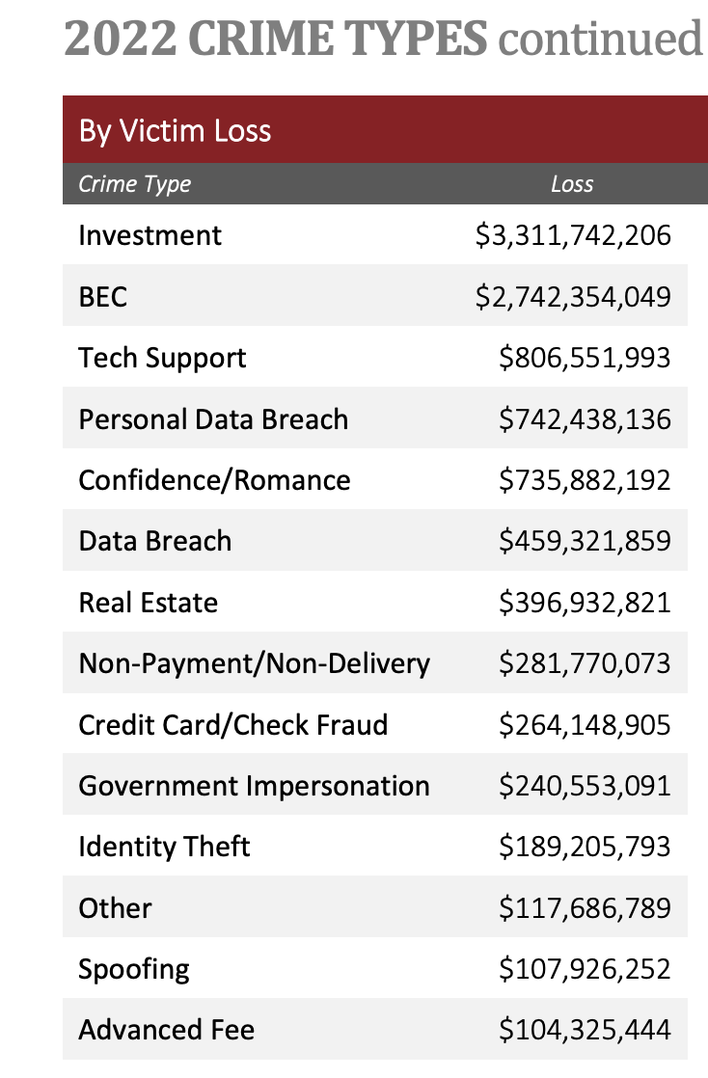
?
?
?
?
?
?
?
?
?
?
?
?
?
?
Notes:
Investment—Deceptive practice that induces investors to make purchases based on false information. These scams usually offer the victims large returns with minimal risk. (Retirement, 401K, Ponzi, Pyramid, etc.).
BEC (Business Email Compromise, not Bacon Egg and Cheese) — BEC is a scam targeting businesses or individuals working with suppliers and/or businesses regularly performing wire transfer payments. These sophisticated scams are carried out by fraudsters by compromising email accounts and other forms of communication such as phone numbers and virtual meeting applications, through social engineering or computer intrusion techniques to conduct unauthorized transfer of funds.
Tech Support — Subject posing as technical or customer support/service
Personal Data Breach — A leak/spill of personal data which is released from a secure location to an untrusted environment. Also, a security incident in which an individual’s sensitive, protected, or confidential data is copied, transmitted, viewed, stolen, or used by an unauthorized individual
Confidence/Romance — An individual believes they are in a relationship (family, friendly, or romantic) and are tricked into sending money, personal and financial information, or items of value to the perpetrator or to launder money or items to assist the perpetrator. This includes the Grandparent’s Scheme and any scheme in which the perpetrator preys on the complainant’s “heartstrings.”

Slide 41
?
?
?
?
?
?
?
?
?
?
?
?
?
Notes:
Investment—Hacked grandma on Facebook “I got rich by investing everything in this one definitely very real cryptocoin”
BEC (Business Email Compromise, not Bacon Egg and Cheese) — “Hey it’s the CEO of your company, wire me $1m right now it’s urgent” or “Hi it’s your professor”
Personal Data Breach — A leak/spill of personal data which is released from a secure location to an untrusted environment. Also, a security incident in which an individual’s sensitive, protected, or confidential data is copied, transmitted, viewed, stolen, or used by an unauthorized individual
Confidence/Romance — An individual believes they are in a relationship (family, friendly, or romantic) and are tricked into sending money, personal and financial information, or items of value to the perpetrator or to launder money or items to assist the perpetrator. This includes the Grandparent’s Scheme and any scheme in which the perpetrator preys on the complainant’s “heartstrings.”

Slide 42
?
?
?
?
?
?
?
?
?
?
?
?
Notes:
Investment—Deceptive practice that induces investors to make purchases based on false information. These scams usually offer the victims large returns with minimal risk. (Retirement, 401K, Ponzi, Pyramid, etc.).
BEC (Business Email Compromise, not Bacon Egg and Cheese) — BEC is a scam targeting businesses or individuals working with suppliers and/or businesses regularly performing wire transfer payments. These sophisticated scams are carried out by fraudsters by compromising email accounts and other forms of communication such as phone numbers and virtual meeting applications, through social engineering or computer intrusion techniques to conduct unauthorized transfer of funds.
Tech Support — Subject posing as technical or customer support/service
Personal Data Breach — A leak/spill of personal data which is released from a secure location to an untrusted environment. Also, a security incident in which an individual’s sensitive, protected, or confidential data is copied, transmitted, viewed, stolen, or used by an unauthorized individual
Confidence/Romance — An individual believes they are in a relationship (family, friendly, or romantic) and are tricked into sending money, personal and financial information, or items of value to the perpetrator or to launder money or items to assist the perpetrator. This includes the Grandparent’s Scheme and any scheme in which the perpetrator preys on the complainant’s “heartstrings.”

Slide 43
?
?
?
?
?
?
?
?
?
?
?
Notes:
Investment—Deceptive practice that induces investors to make purchases based on false information. These scams usually offer the victims large returns with minimal risk. (Retirement, 401K, Ponzi, Pyramid, etc.).
BEC (Business Email Compromise, not Bacon Egg and Cheese) — BEC is a scam targeting businesses or individuals working with suppliers and/or businesses regularly performing wire transfer payments. These sophisticated scams are carried out by fraudsters by compromising email accounts and other forms of communication such as phone numbers and virtual meeting applications, through social engineering or computer intrusion techniques to conduct unauthorized transfer of funds.
Tech Support — Subject posing as technical or customer support/service
Personal Data Breach — A leak/spill of personal data which is released from a secure location to an untrusted environment. Also, a security incident in which an individual’s sensitive, protected, or confidential data is copied, transmitted, viewed, stolen, or used by an unauthorized individual
Confidence/Romance — An individual believes they are in a relationship (family, friendly, or romantic) and are tricked into sending money, personal and financial information, or items of value to the perpetrator or to launder money or items to assist the perpetrator. This includes the Grandparent’s Scheme and any scheme in which the perpetrator preys on the complainant’s “heartstrings.”

Slide 44
?
?
?
?
?
?
?
?
?
?
Notes:
Investment—Deceptive practice that induces investors to make purchases based on false information. These scams usually offer the victims large returns with minimal risk. (Retirement, 401K, Ponzi, Pyramid, etc.).
BEC (Business Email Compromise, not Bacon Egg and Cheese) — BEC is a scam targeting businesses or individuals working with suppliers and/or businesses regularly performing wire transfer payments. These sophisticated scams are carried out by fraudsters by compromising email accounts and other forms of communication such as phone numbers and virtual meeting applications, through social engineering or computer intrusion techniques to conduct unauthorized transfer of funds.
Tech Support — Subject posing as technical or customer support/service
Personal Data Breach — A leak/spill of personal data which is released from a secure location to an untrusted environment. Also, a security incident in which an individual’s sensitive, protected, or confidential data is copied, transmitted, viewed, stolen, or used by an unauthorized individual
Confidence/Romance — An individual believes they are in a relationship (family, friendly, or romantic) and are tricked into sending money, personal and financial information, or items of value to the perpetrator or to launder money or items to assist the perpetrator. This includes the Grandparent’s Scheme and any scheme in which the perpetrator preys on the complainant’s “heartstrings.”

Slide 45
?
?
?
?
?
?
?
?
?
Notes:
Investment—Deceptive practice that induces investors to make purchases based on false information. These scams usually offer the victims large returns with minimal risk. (Retirement, 401K, Ponzi, Pyramid, etc.).
BEC (Business Email Compromise, not Bacon Egg and Cheese) — BEC is a scam targeting businesses or individuals working with suppliers and/or businesses regularly performing wire transfer payments. These sophisticated scams are carried out by fraudsters by compromising email accounts and other forms of communication such as phone numbers and virtual meeting applications, through social engineering or computer intrusion techniques to conduct unauthorized transfer of funds.
Tech Support — Subject posing as technical or customer support/service
Personal Data Breach — A leak/spill of personal data which is released from a secure location to an untrusted environment. Also, a security incident in which an individual’s sensitive, protected, or confidential data is copied, transmitted, viewed, stolen, or used by an unauthorized individual
Confidence/Romance — An individual believes they are in a relationship (family, friendly, or romantic) and are tricked into sending money, personal and financial information, or items of value to the perpetrator or to launder money or items to assist the perpetrator. This includes the Grandparent’s Scheme and any scheme in which the perpetrator preys on the complainant’s “heartstrings.”

Slide 46
Notes:
Here’s the rest. Which of these should be priorities for computer scientists? Most of these — even the ones that don’t seem like security problems — stem from the abuse of the Internet’s lack of strong identification. Can someone tell me the difference between identification and authentication? Why don’t we see works on stopping business email compromise in security conferences? Another question — where is ransomware??? IC3 reported (only) $34m in losses in 2022 from ransomware. What’s going on?
Is this due to a lack of reporting?
Is it really just that much less of an issue than the others?
Odd because it seems to be one of the very top priority topics in the security community.

Slide 47
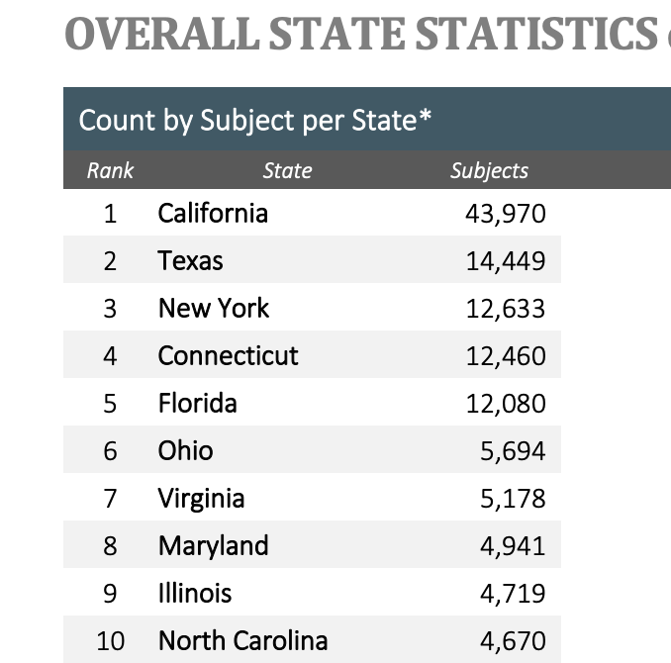
???
Notes:
California: One complaint for every 900 people
Connecticut: One complaint for every 300 people?
Is there more crime? Or do they report more?

Slide 48
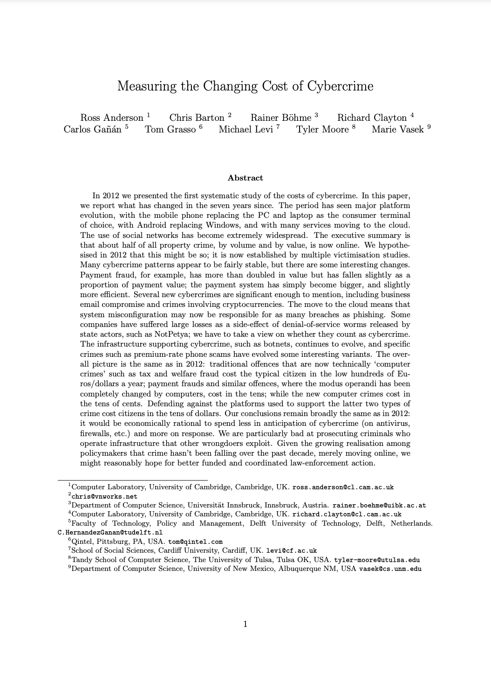

Slide 49
Three types of costs
Direct losses
Notes:
Losses, damages, + other suffering as a consequence of cybercrime. Examples include money withdrawn from victim accounts; time and effort to
reset account credentials after compromise (for both banks and consumers); and lost attention
and bandwidth caused by spam messages.

Slide 50
Three types of costs
Direct losses
Indirect losses
Notes:
Indirect loss is the value of the losses and opportunity costs imposed on society by the fact that a certain type of cybercrime is carried out. Indirect costs generally cannot be attributed to individual perpetrators or victims. Examples include loss of trust in online banking, leading to reduced revenues from transaction fees and higher costs for maintaining branch staff; sales foregone by online retailers when their fraud engines cause them to decline shopping baskets; reduced uptake by citizens of electronic services whether from companies or governments; cancelled operations due to online medical services being unavailable; and efforts to clean up machines infected with botnet malware.

Slide 51
Three types of costs
Direct losses
Indirect losses
Defense Costs
Notes:
Defence costs measure prevention efforts. They include security products such as spam filters and antivirus; security services provided to individuals, such as awareness raising; security services provided to industry, such as website ‘take-down’ services; fraud detection and recovery efforts; law enforcement; and opportunity costs such as the inconvenience of missing messages falsely classified as spam.

Slide 52
Three types of costs
Direct losses
Indirect losses
Total cost of cybercrime
Defense Costs
Notes:
In their model, the total social cost of cybercrime is the sum of direct losses, indirect losses, and defence costs. The bulk of the paper is estimating these costs for various types of cybercrime, which they do by referencing and synthesizing prior reports and studies from government and industry.
We don’t have time to walk through each of them so I’ll skip to the results.

Slide 53
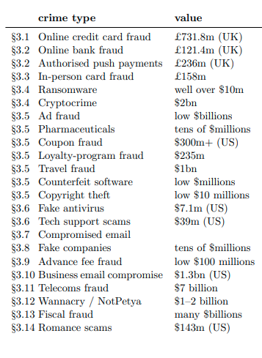
Notes:
What stands out?

Slide 54
(2017)
Notes:
These underlined crime types are the ones that are estimated to have costs in the billions
What’s missing? Keep in mind this was 2017

Slide 55
(2017)
Notes:
$2017

Slide 56
(2017)
Notes:
These underlined crime types are the ones that are estimated to have costs in the billions
What’s missing? Keep in mind this was 2017

Slide 57
(2017)
Notes:
These underlined crime types are the ones that are estimated to have costs in the billions
What’s missing? Keep in mind this was 2017

Slide 58
(2017)
Notes:
These underlined crime types are the ones that are estimated to have costs in the billions
What’s missing? Keep in mind this was 2017

Slide 59
(2017)
?
Notes:
These underlined crime types are the ones that are estimated to have costs in the billions
What’s missing? Keep in mind this was 2017

Slide 60
(2017)
?
Notes:
The costs of data breaches are often come in the form of card or bank fraud, so maybe we can connect these two. Seems plausible

Slide 61
(2017)
Notes:
The costs of data breaches are often come in the form of card or bank fraud, so maybe we can connect these two. Seems plausible

Slide 62
Discussion
Many of the costliest crimes (e.g. BEC and tech support scams) do not seem to be a priority for the security community. Why?

